Slide 1
Title of Topic: Three Level DBMS Architecture Course Code: 23IT201 Course Title: DataBase Management Systems Session Number: 2 Academic Year: 2024 - 2025 (Even Sem)
23IT201-DATABASE MANAGEMENT SYSTEMS
MODULE 1-INTRODUCTION

Slide 2
1. Introduction to DBMS, Characteristics of DBMS, DBMS vs File Systems, need for DBMS. 2. Three Level DBMS Architecture 3. Data Models Introduction, Benefits, and Phases 4. ER Diagrams – Symbols, Components, Relationships, Weak entities, Attributes, Cardinality. 5. Relational Algebra, Domain Relational Calculus, Tuple Relational 6.Calculus Keys - primary Key, Foreign Key.
23IT201-DATABASE MANAGEMENT SYSTEMS
MODULE 1-INTRODUCTION
MODULE 1-INTRODUCTION
2

Slide 3
23IT201-DATABASE MANAGEMENT SYSTEMS
Three Level DBMS Architecture
Topics to be Covered
Data Abstraction
Levels of Data Abstraction
Data Independence
Types of Data Independence
Data Independence in File System vs DataBase System
DBMS Architecture
DataBase System Architecture
MODULE 1-INTRODUCTION

Slide 4

23IT201-DATABASE MANAGEMENT SYSTEMS
Data Abstraction
The process of hiding certain details of database from user
Hides some details like how data is stored and created Provides only the required data
A database system that is able to separate the three different views is likely to be flexible and adaptable
This flexibility and adaptability is called data abstraction
Data Abstraction:
MODULE 1-INTRODUCTION

Slide 5
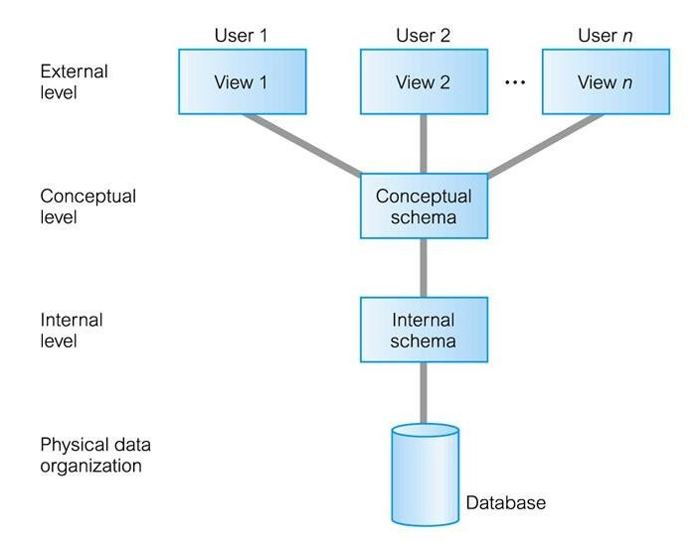
23IT201-DATABASE MANAGEMENT SYSTEMS
Levels of Data Abstraction
Architecture based on user view (or) functions
ANSI/SPARC produced an architectural framework for databases with three different views of the data
Used for describing the structure of specific database systems
Architecture:
MODULE 1-INTRODUCTION

Slide 7
23IT201-DATABASE MANAGEMENT SYSTEMS
Levels of Data Abstraction
Internal/Physical View at Internal/Physical Level
Lowest level of data abstraction which has the knowledge about s/w and h/w
Describes what data is stored in the database system and how
Describes complex low-level data structures in detail
Keeps the information about the actual representation of the entire database
Closest to the physical storage and does not deal with the physical devices directly
Instead it views a physical device as a collection of physical pages and allocates space in terms of logical pages
Also considers file organization, storage allocation, access paths of indexes, data compression and encryption techniques and record placement
MODULE 1-INTRODUCTION

Slide 8
23IT201-DATABASE MANAGEMENT SYSTEMS
Levels of Data Abstraction
Conceptual View at Logical Level
Next higher level of abstraction (Inbetween user level and physical level)
Describes what data are stored in the database and what relationship exist among these data
Describes entire database in terms of small number of relatively simple structures and more stable than other two views
Hides the details of physical storage structures and concentrates on describing entities, data types, relationships, user operations and constraints
Consists of conceptual schema which can be changed without changing anything in the application
MODULE 1-INTRODUCTION

Slide 9
23IT201-DATABASE MANAGEMENT SYSTEMS
Levels of Data Abstraction
External View at External Level
Highest or Top level of data abstraction (No knowledge of DBMS s/w, h/w or physical storage) concerned with the user
Describes only part of the entire database that a particular user i interested in and hides the rest of the database from user
There can be n number of external views for database where n is the number of users
E.g., An accounts department is only interested in the student fee details. It does not have any interest in the personal information about students
All the database users work on external level of DBMS
Views of individual users are defined by means of external schemas
MODULE 1-INTRODUCTION

Slide 10
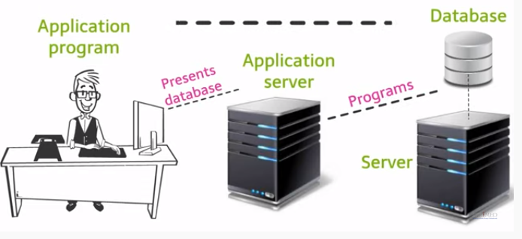
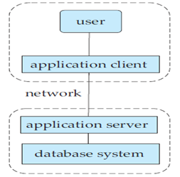
23IT201-DATABASE MANAGEMENT SYSTEMS
DBMS Architecture
3-Tier Architecture
Application program runs on client side and Database is stored on server
An intermediate layer called application layer is stored on a separate server
This layer stores the programs that access the database from database server
MODULE 1-INTRODUCTION

Slide 11
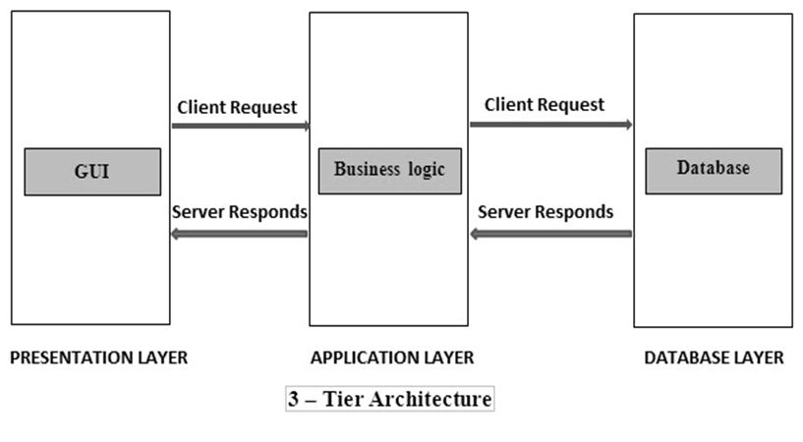
23IT201-DATABASE MANAGEMENT SYSTEMS
DBMS Architecture
3-Tier Architecture
Application layer presents the data to the user in a required form
Three layer work together to create 3-Tier Architecture
Each of the layer can be operated and managed individually
E.g., Web Application such as E-Commerce
MODULE 1-INTRODUCTION

Slide 12
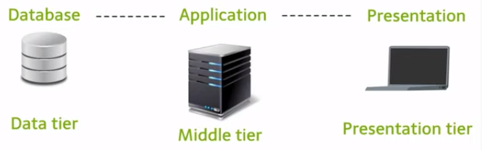
23IT201-DATABASE MANAGEMENT SYSTEMS
DBMS Architecture
N-Tier Architecture
Used in web based application with three layers/tiers
N-Tier architecture begins as a 3-Tier model
E.g., Any large website on the internet
MODULE 1-INTRODUCTION

Slide 13
23IT201-DATABASE MANAGEMENT SYSTEMS
DBMS Architecture
Middle Tier (Application Layer)
Contains business logic and communicates between the client and server
Holds the application server and the programs that access the database
End users are unaware of any existence of the database beyond the application tier and not aware of any other user beyond the application tier
Also processes functional logic, constraint, and rules before passing data to the user or down to the DBMS
Data Tier
Manages the database
Databases resides along with its query processing languages and the respective relations
MODULE 1-INTRODUCTION

Slide 14
23IT201-DATABASE MANAGEMENT SYSTEMS
DBMS Architecture
Presentation Tier (Client Layer)
Interface between the user and the system
Contains GUI part of the system (your PC, Tablet, Mobile, etc…)
All end users operate on this tier
Multiple views of the database can be provided by the application
All views are generated by the application that reside in the application tier
Advantages
Easy to maintain and modify without affecting other modules
Improved Security as client cannot access the database easily
Improved Performance and Data Integrity, also Fast Communication
MODULE 1-INTRODUCTION

Slide 15
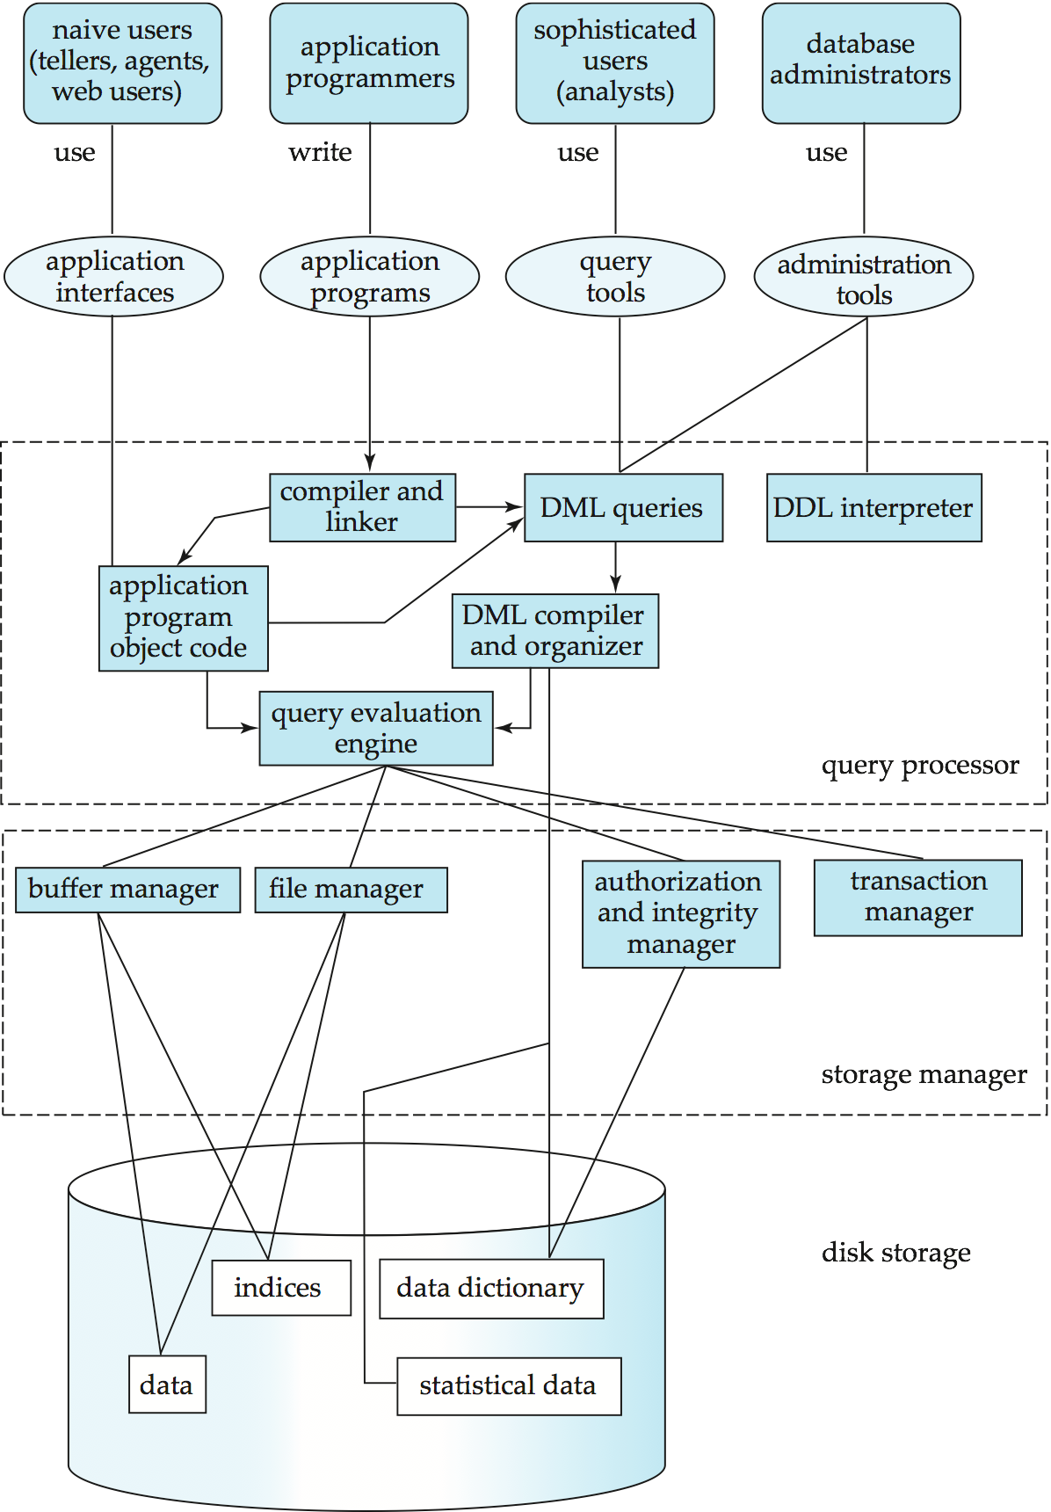
23IT201-DATABASE MANAGEMENT SYSTEMS
DataBase System Architecture
Allows communication between different types of user with physical DB and OS
Architecture:
MODULE 1-INTRODUCTION

Slide 16
23IT201-DATABASE MANAGEMENT SYSTEMS
Database System Architecture
User Communication, Authentication and Authorization
Deals with the user when he/she communicates with the DBMS
Communication depends on the kind of DBMS (2-TIER or 3-tier)
User first log on to the system and has to be authenticated
Once the user is allowed to access the database, the system will check the user’s credentials
Naive users use application interfaces
Application programmers write application programs
Sophisticated users use query tools
Database Administrators use administration tools
MODULE 1-INTRODUCTION

Slide 17
23IT201-DATABASE MANAGEMENT SYSTEMS
DataBase System Architecture
Query Processor (Executes of DDL and DML statements)
Application program object code - Directly connected with application interface
Compiler - Connected with application program will compile them
DML Queries - Connected with query tools
DDL Interpreter – Interprets DDL statements into a set of tables containing metadata
DML Compiler and Organizer – Translates DML statements into low level instructions that the query evaluation engine understands
Query Evaluation Engine – Executes low level instructions generated by DML compiler
MODULE 1-INTRODUCTION

Slide 18
23IT201-DATABASE MANAGEMENT SYSTEMS
DataBase System Architecture
Storage Manager
Provides interface between low-level data stored and application program or queries
Transaction Manager – Simply preserves atomicity (all or none) and controls concurrency (coordination of the simultaneous execution of transactions in a multiprocessing database)
Authorization and Integrity Manager – Checks the authority of users to access data and integrity constraints
File Manager – Manages allocation of space on disk storage
Buffer Manager – Fetches data from disk storage to memory for being used
MODULE 1-INTRODUCTION

Slide 19
23IT201-DATABASE MANAGEMENT SYSTEMS
DataBase System Architecture
Disk Storage
Where the actual data is stored
Data Dictionary – Store metadata (data about data)
Indices – Provide faster access to data items
Data – Store user data (Nothing but warehouse)
Statistical Data – Store statistical information about the data
MODULE 1-INTRODUCTION

Slide 20
23IT201-DATABASE MANAGEMENT SYSTEMS
Three Level DBMS Architecture & Data Abstraction, Data Independence, DB System Architecture
Summary
Data Abstraction
Levels of Data Abstraction
Data Independence
Types of Data Independence
Data Independence in File System vs DataBase System
DBMS Architecture
DataBase System Architecture
MODULE 1-INTRODUCTION

Slide 21
23IT201-DATABASE MANAGEMENT SYSTEMS
Three Level DBMS Architecture & Data Abstraction, Data Independence, DB System Architecture
Try Yourself
A learner of DBMS store and manipulate the data on the same system. Find the architecture used in this system.
If you have used MySQL, then you must have seen PHPMyAdmin. Identify which type of architecture is followed in this system.
Identify the architecture used in Desktop Games.
Draw the three-level data abstraction for
Customer Database with the attributes such as Cust_ID, F_Name, L_Name, Contact Number, SSN, City.
Employee Database with the attributes such as Empl_No, F_Name, L_Name, Age, Salary, DoB, Branch_No.
MODULE 1-INTRODUCTION

Slide 22
23IT201-DATABASE MANAGEMENT SYSTEMS
Session 3 - Introductions to Data Models-Hierarchical Model, Network Model, Object Oriented Model, Entity–Relationship Model, Relational Model
MODULE 1-INTRODUCTION

